Slide 1
Unpacking raw data as Protocol Stack for L3 and L4
Vigneshwaran Venugopal

Slide 2

Client Server Connection of the program
Unpacking of 8 but array numbers to L4 header using L4 header
Client
L4
Unpacking of 8 but array numbers to L3 header using the L3 Class
L3
Server
Data sent in 0’s and 1’s

Slide 3
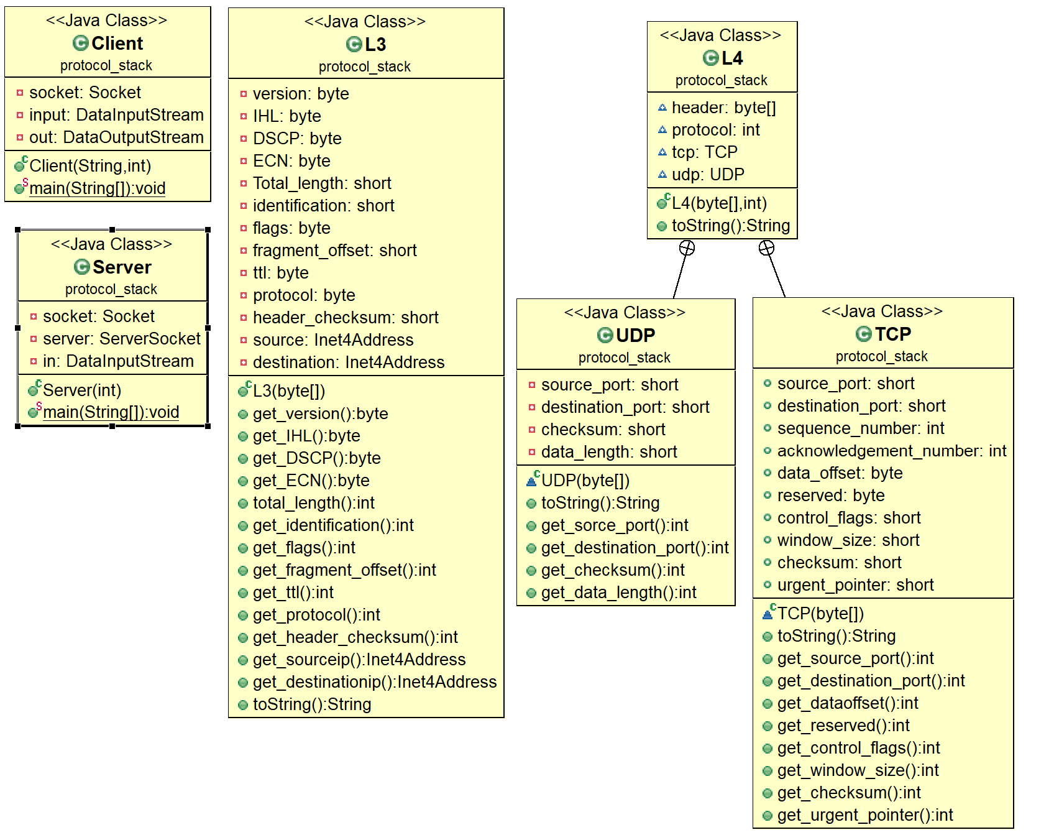
Class Diagram

Slide 4
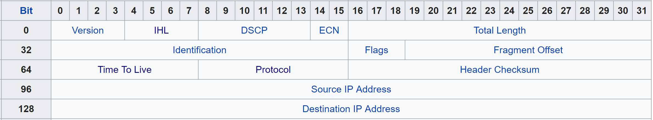
L3 Header
Input Data: 8 bit Integer values
69 130 140 150 160 170 180 190 200 6 251 219 240 230 220 210

Slide 5
Bitwise operations
Taking into count the first byte 0100 0101 = 69 (Decimal)
01000101
69
?
0100 0101
4 5
To do this we need to do bitwise operation on the given number,
01000101
69
Right Shift
4
0100
4
01000101
69
& 15
0101
5
Similarly we can manipulate the bits to get all the header files from the raw data.

Slide 6
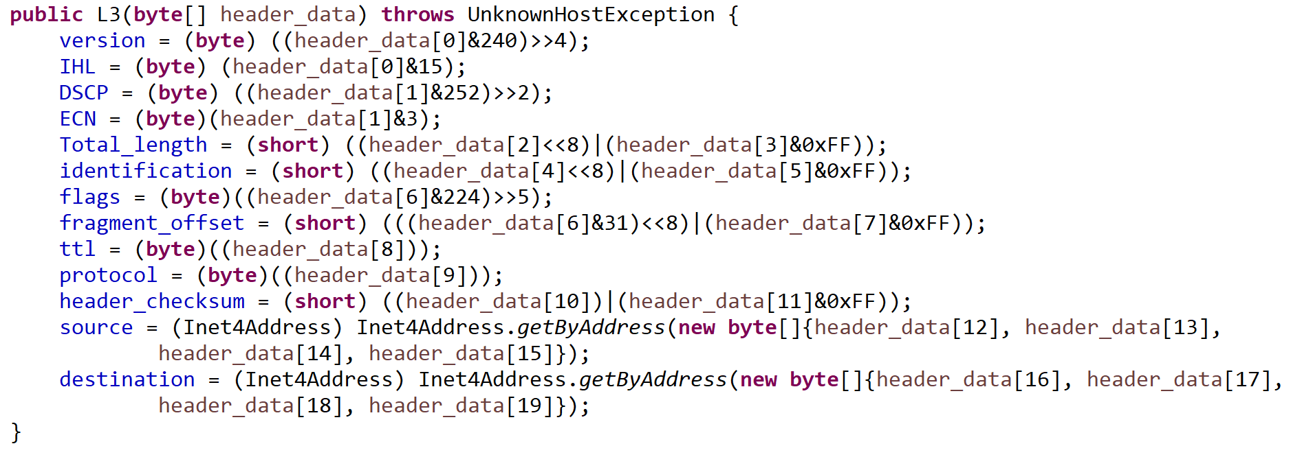
Java Program that does bit manipulation for ipv4

Slide 7
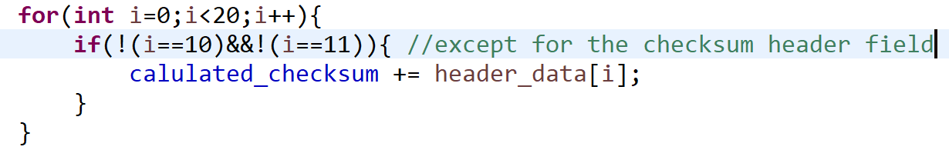
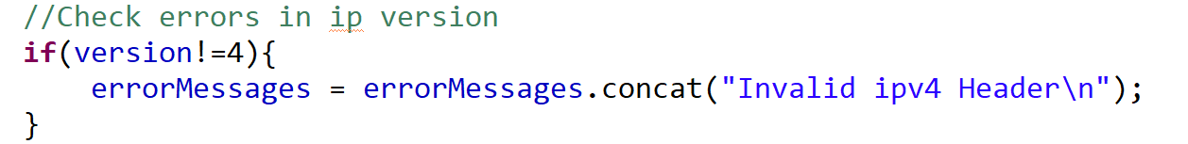
Error Handling
Checksum:
The client calculates the checksum of the ip4, tcp and udp. If there is a difference calculated and the given error then error messages are sent to the display.
IP version Errors:
The server checks to see if the IP version is 4. If its is not 4, it displays an error message.

Slide 8
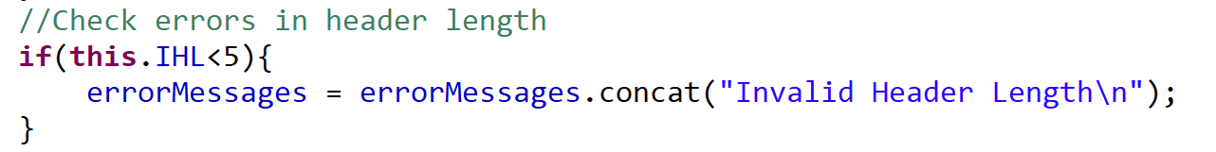
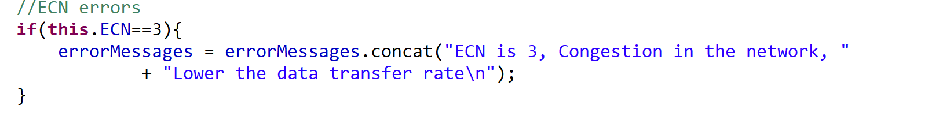
Header Length Errors:
The minimum value of the IHL is 5 which is 5*4=20 bytes. If the value is less than 5, then the L3 class gives out an error message.
ECN:
The ECN header when enabled denotes congestion. In this case it gives out an error message. The real time the server reduces the data transfer rate

Slide 9


Slide 10


